Slide 1


Slide 2

SUPPLIERS INDUCTION & VENUE BRIEFING
Wednesday, 18th June 2025
Events Management Queensland

Slide 3

INTRODUCTION
EMQ Logan Larkin – General Manager Event Operations Michelle Wamelink – Event Manager Precinct Justin Laws – Event Manager Course
EVENTCO Darren Bell, Steve Bell, Ross Davey, Steven Sextone Em Biviano, Ashley Reid Precinct Managers & Production
AROUND THE TABLE INTRODUCTION Hello!

Slide 4

AGENDA
Today’s briefing
Suppliers Induction
Site Rules
Precinct Plan Review
Build Timelines

Slide 5

SUPPLIERS INDUCTION
Events Management Queensland has a legal responsibility to protect the health, safety and welfare at work of employees and others.
And to maintain a safe place to work with the right systems in place.
These practices are in-line with the WHS policy of the Gold Coast Marathon.

Slide 6
SUPPLIERS INDUCTION
Events Management Queensland has a legal responsibility to:
Ensure the event runs smoothly and ensures all WHS measures are in place during both the build and over the race weekend
Address all safety issues
Liaise with local authorities
Monitor and enforce safe work practices
Enforce site rules – non-compliance notices will be issued
Safety Officers will be monitoring during the build phase to ensure safety is maintained at the highest level
Any contractor or personnel caught putting themselves/others in danger or not adhering to our site rules will be notified in writing with a non-compliance notice
Notes:
dfasfs

Slide 7
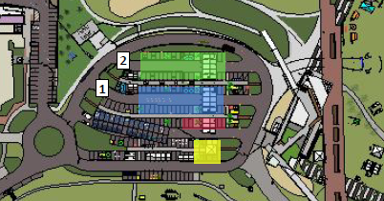
SUPPLIER INDUCTION
Accidents or incidents To a person, venue or property. Report to your supervisor and report all accidents, incidents or near misses to the safety officers at Marathon HQ Arrival on site Visit Marathon HQ and see the Eventco team. They will advise you what the schedule for the day is. There are two-way radios available to assist with communication throughout the day
Notes:
Accidents or incidents
To a person, venue or property – report to your supervisor and report all accidents, incidents or near misses to the safety officers at Marathon HQ
Arrival on site
Visit Marathon HQ and see the Eventco team. They wll advise you what the schedule for the day is. There are two-way radios available to assist with communication throughout the day.

Slide 8
SUPPLIERS INDUCTION
First Aid
First Aid Officer EMQ Logan Larkin
First Aid Officer Eventco Em Biviano
First Aid Kit is available at Marathon HQ

Slide 9


SUPPLIERS INDUCTION
Site Safety
Use safety barriers around your work site
Safety tape around palletised structures that are in public areas overnight
Use safety advisory signage
Forklift spotters always!
Speed limit 10km
Notes:
dfasfs

Slide 10


SUPPLIERS INDUCTION
PPE
Personal Protective Equipment
Steel Cap Boots – MANDATORY
Hi Vis Vest – MANDATORY
Hat – Advised
Sunscreen - Advised

Slide 11
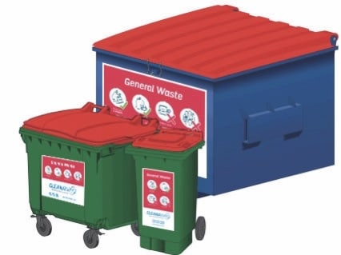
SUPPLIERS INDUCTION
WASTE
Use bins provided
Please ensure the correct waste goes into the applicable bin
Comingle bulk bins, recycling, general waste bins and cardboard cages will be provided during bump-in

Slide 12

SUPPLIERS INDUCTION
EVACUATION
If evacuation is required during build phase, a megaphone loud-hailer siren will be used. Please follow the site managers instruction.
GENERAL
Don’t park or drive vehicles on lawns – seek approval if necessary
Ground protection must be used if lawns are deemed too soft
Water provided by NU PURE for all crew and is available at HQ
Mark out of the site will be done in stages as build progresses

Slide 13


SUPPLIERS INDUCTION
PARKING
Vehicle Parking Permit to be used by all EMQ staff, Parklands staff, Suppliers & Contractors during bump-in and bump-out
All vehicle passes to have name and contact number written and placed on dashboard
No Parking on site race weekend. For staff working race weekend parking is available at Mitchell Park. Inform Marathon HQ if you need to park here pre-race weekend

Slide 14
SITE RULES
KNOW
THE
RULES
Please read site rules & sign
Always adhere to the site rules
As representatives of your company, once you read and sign the site rules, it is your responsibility to brief your crew

Slide 15
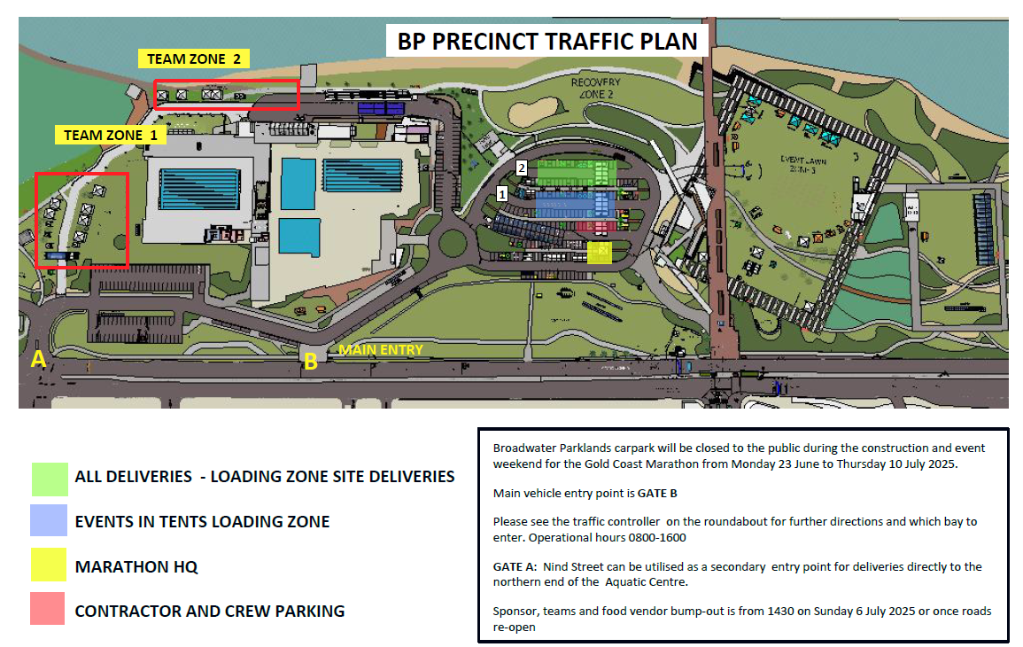

Slide 16
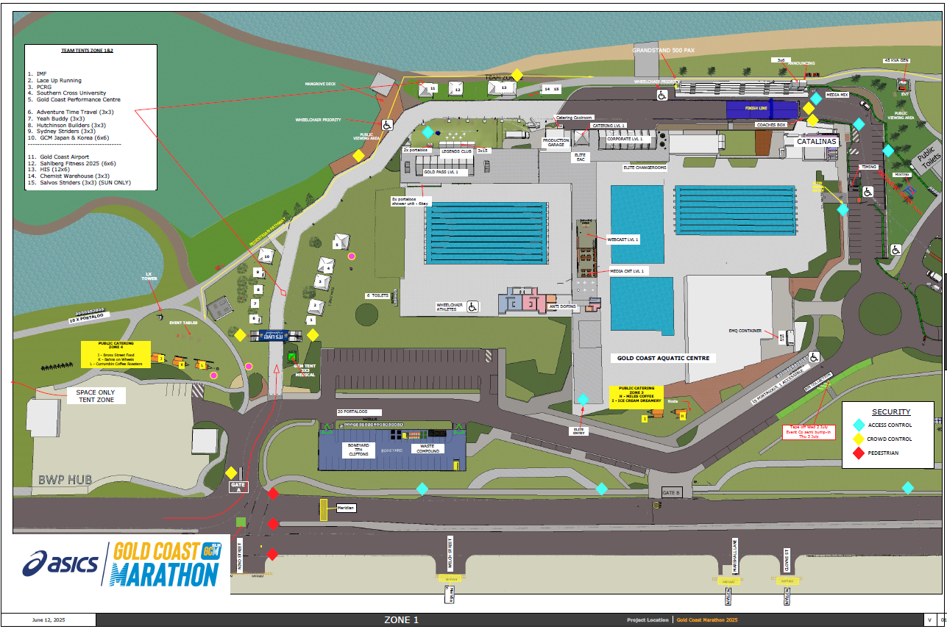
SITE PLAN
Zone 1

Slide 17
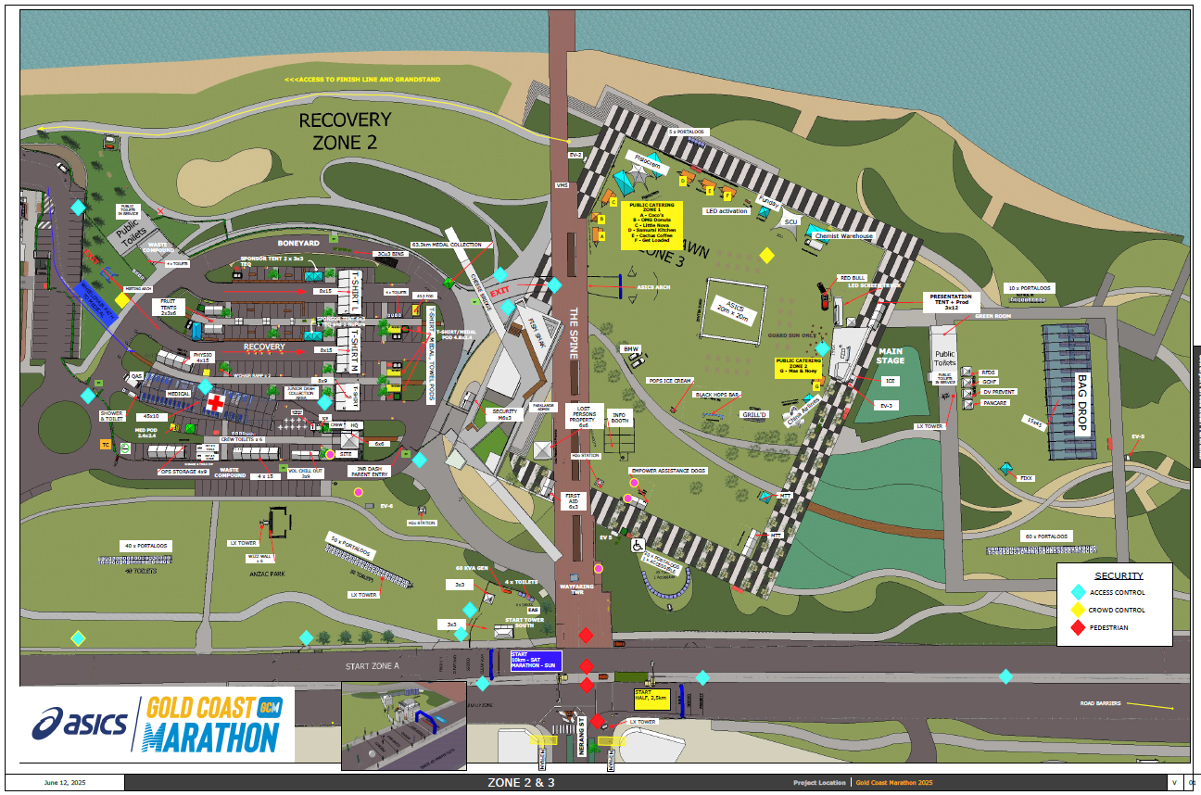
SITE PLAN
Zone 2 & 3

Slide 18
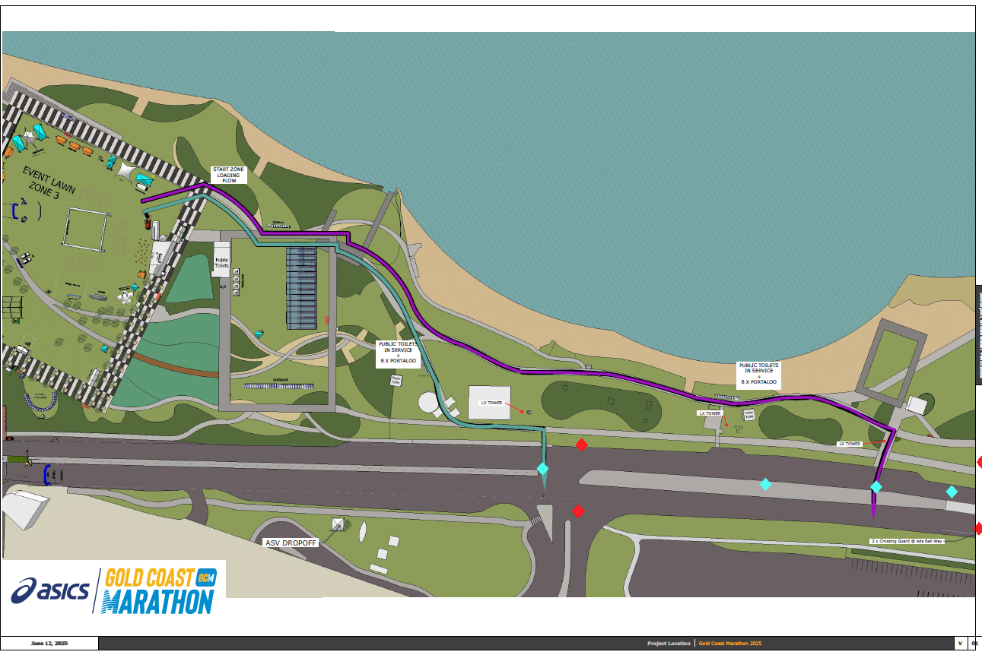
SITE PLAN
Zone 4

Slide 19
BUMP-IN
Site build | Monday 23rd June - Friday, 4th July
IMPORTANT: Mon 23/06 – Fri 27/06 → No marquee build on Event Lawn (Lost persons / Public First Aid / Presentations approved)
TFH – Friday 20th June – HQ Sheds drop-off
Eventco – From Monday, 23rd June onwards
Events in Tents – Monday, 23rd June Medical/Signage/HQ/Recovery etc
EventElec – Monday, 23rd June / Thursday, 26th June
Cliftons – Tue 24th – Fri 27th June – GCAC to BP (Bump-out reverse order)
Cleanaway – Delivery week 1 – Monday, 23rd June
COGC 2x Asphalt ramp at Misting tent – Tuesday 1st July
1Stop Plumbing – Monday, 30th June & Thursday, 3rd July
1SEQ Security – From Monday, 23rd June
Microhire – Wednesday 2nd July / Friday 4th July
Notes:
dfasfs

Slide 20
Questions
Are there any questions?
Who would like a site tour?

Slide 21
THANK YOU!
Wednesday, 18th June 2025
Events Management Queensland

